Slide 1
SEQUENCE AND SERIES
CLASS XI
MATHEMATICS

Slide 2
DEFINATION OF SEQUENCE
Sequences
The different numbers occurring in any particular sequence are known as terms. The terms of a sequence are denoted by
a₁, a₂, a₃,….,a_{n}
If a sequence has a finite number of terms then it is known as a finite sequence. A sequence is termed as infinite if it is not having a definite number of terms.
For example The nth term of an AP is given by
a + (n-1) d

Slide 3
ARITHMETICS PROGRESSION
Between any two numbers ‘a’ and ‘b’, n numbers can be inserted such that the resulting sequence is an Arithmetic Progression. A_{1,} A_{2,} A_{3,……,}A_{n} be n numbers between a and b such that a, A_{1 ,} A_{2 ,} A_{3,……,}A_{n}, b is in A.P.
Here, a is the 1st term and b is (n+2)th term. Therefore,
b = a + d[(n + 2) – 1] = a + d (n + 1).

Slide 4
SUM TO n th TERM OF AN A P
Sum of nth term:
S_{n} = n/2 [2a + (n-1)d]
where n = number of terms, a = first term and d = common difference

Slide 5
Geometrical Progression
The nth term of a geometric progression is
given by a_{n} = ar^{n-1}
an is n th term and r= common ratio of GP

Slide 6
Arithmetic Mean
(c) If a, A₁ , A₂ , A₃ ,…,A_{n}, b are in AP, then A₁, A₂, A₃,…, A_{n} are n arithmetic mean between a and b, where
(d) Sum of n AM’s between a and b is nA
i.e., A₁ + A₂ + A₃ + + = nA

Slide 7
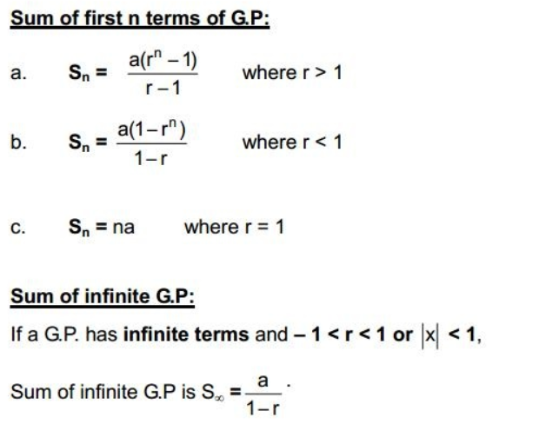
Sum of n Terms of a GP

Slide 8
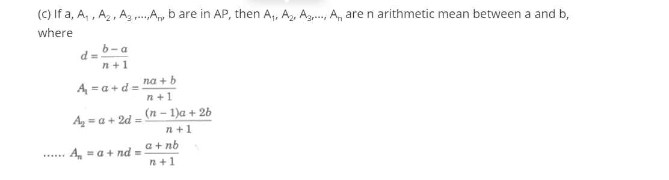
Arithmetic Mean

Slide 9
Definition of Geometric Mean
If three quantities are in Geometric Progression then the middle one is called the geometric mean of the other two.
Let, three numbers a, G and b are in Geometric Progression then, the middle number G is called the geometric mean between two numbers a and b.⇔ a, G, b are in Geometric Progression
⇔ GaGa = bGbG = common ratio.
⇔ G22 = ab
⇔ G = ±√ab
Solved example

Slide 10
Solved example of GP
26. Insert two numbers between 3 and 81 so that the resulting sequence is G.P.
Solution:
Let’s assume G₁ and G₂ to be two numbers between 3 and 81 such that the series 3, G₁, G₂, 81 forms a G.P.
And let a be the first term and r be the common ratio of the G.P.

Slide 11
Now, we have the 1st term as 3 and the 4th term as 81.
81 = (3) (r)³
r³ = 27
∴ r = 3 (Taking real roots only)
For r = 3,
G₁ = ar = (3) (3) = 9
G₂ = ar² = (3) (3)² = 27
Therefore, the two numbers which can be inserted between 3 and 81 so that the resulting sequence becomes a G.P are 9 and 27.

